Slide 1
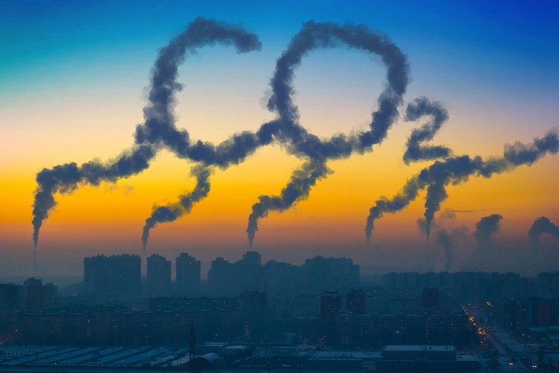
AIR QUALITY FORECASTING
(CO2 Emission)
GROUP 1
Subin Nair
Nithin M
Vishal Sathe
Pravin Chandel
Purva Kaiwart
Bhaskar Subbiah
Mentor:Advaith Sir

Slide 2
CONTENTS
1. Bussiness Objective
2. Flow chart
3. Detail Summary of Data
4. EDA
5. Model Building
6. Model Deployment
7. Conclusion

Slide 3
1. Business Objective: To forecast Co2 levels for an organization so that the organization can follow government norms with respect to Co2 emission levels.
Data Set Details:
Time parameter and levels of Co2 emission

Slide 4
2. Flow Chart
Business Understanding
Exploratory Data Analysis
Feature Engineering
Model Building
Deployment

Slide 5
3. EXPLORATORY DATA ANALYSIS
Shape of dataset is 215 rows and 2 columns.
Data-Type of Dataset is in Float.

Slide 6
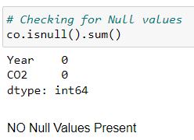
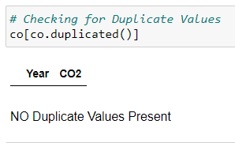
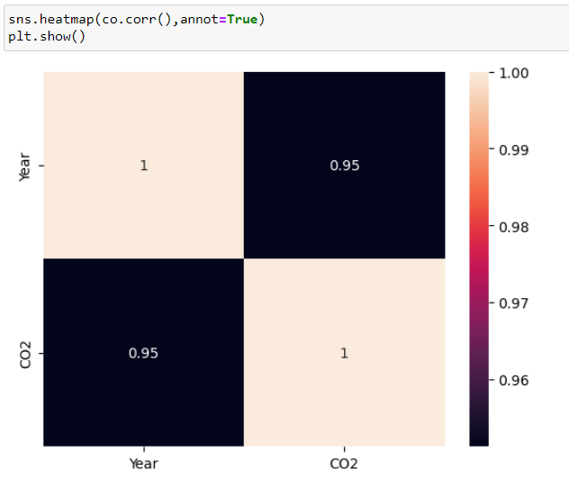
The given dataset has no Null Values, Duplicate Values present in it
The heatmap shows the corelation between them

Slide 7
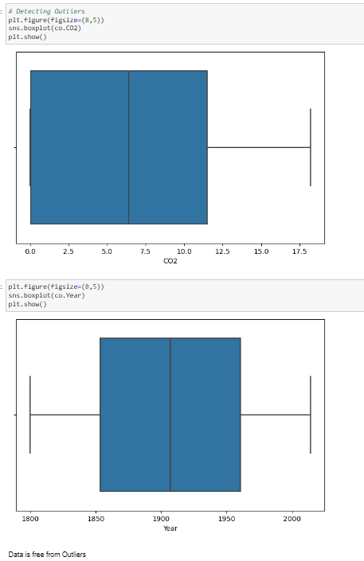
Outlier Detection The Data is free from outliers

Slide 8
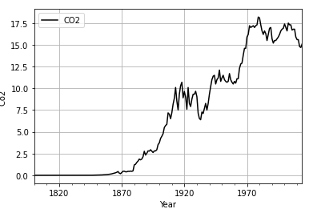
Analyzing Data With Graphs
In lineplot shows that C02 emission over the period of time is increasing therefore data is showing exponential trend but no seasonality is present in data.

Slide 9
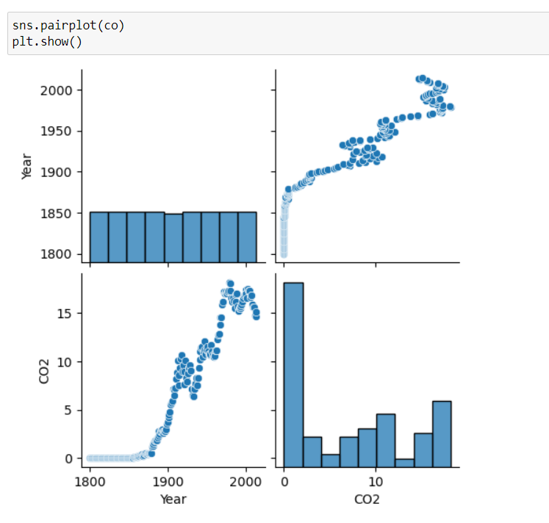
Pair Plot

Slide 10
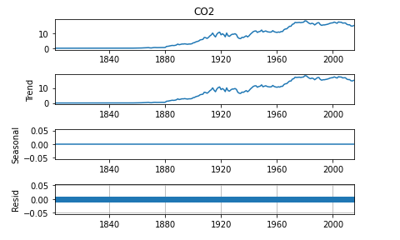
Seasonal Demoposition
Average is not constant for the co2 emission over the period of time
There is a trend followed by data which is of exponential type
Seasonality is not present in the data
There are no residuals

Slide 11
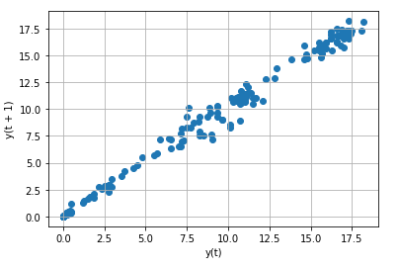
Lag Plot
Lag plots shows that there is positive linear relation between variable and its own lag variable

Slide 12
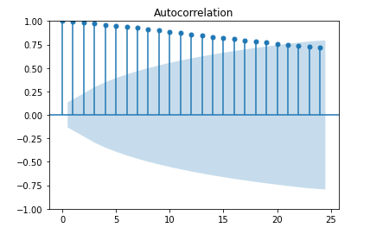
Autocorrelation
The graph we can examine that nearest time lag has good autocorrelation but as we reach time period which are far away the autocorrelation is decreasing.

Slide 13
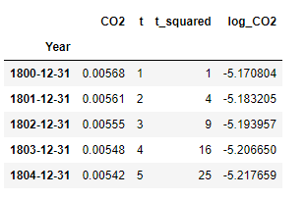
Transformation of data
Including columns : "t"-time,"t_square"-time square,"log_co2"-log of Co2

Slide 14
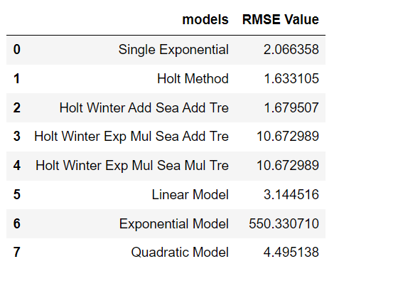
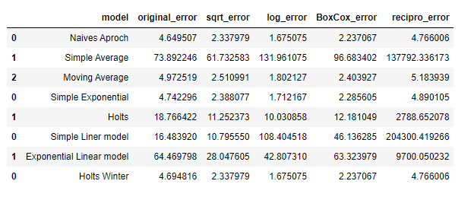
5. Model Building

Slide 15
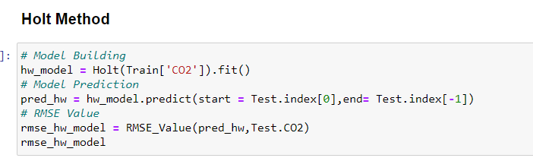
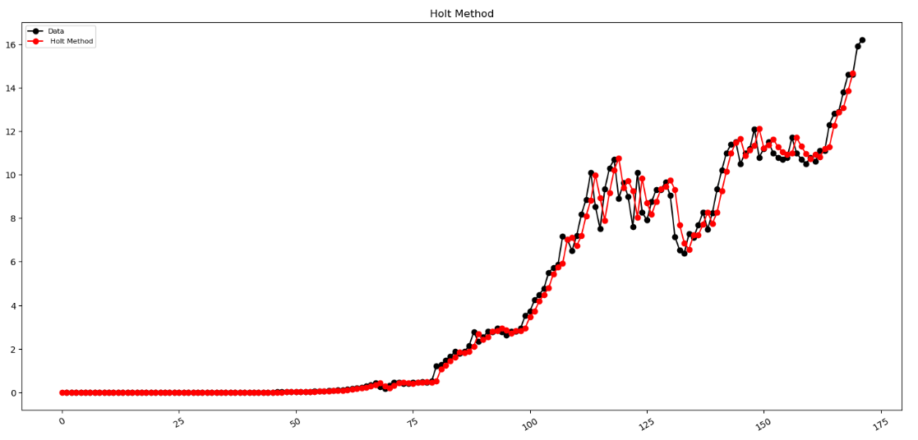
Final model with Holt Method
Holt Method has given least RMSE Value. Therefore we choose Holt Method for Model Building

Slide 16
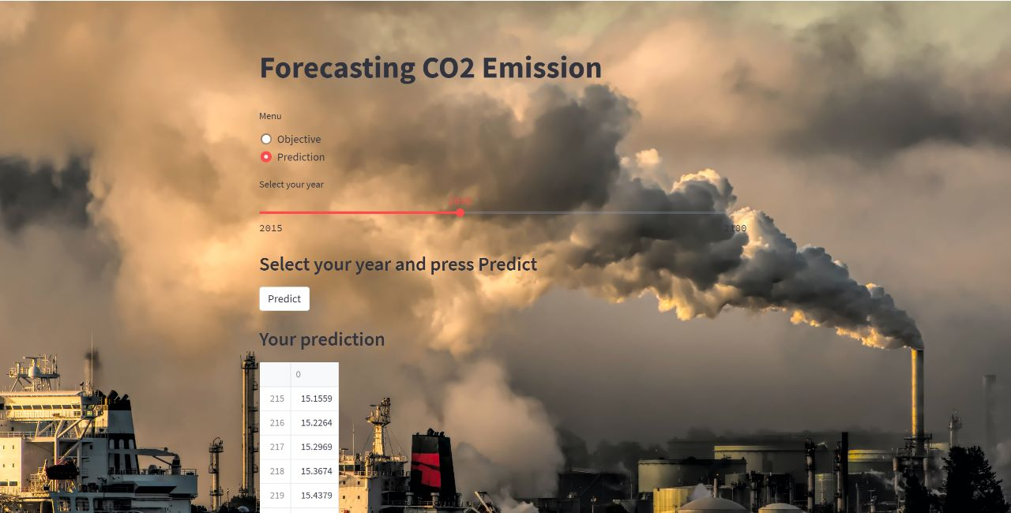
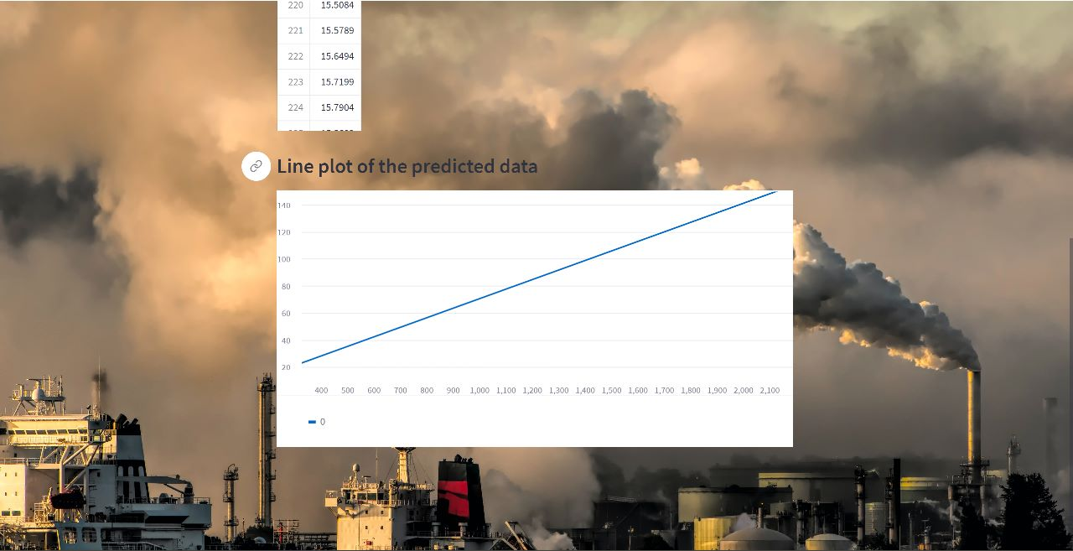
6. Model Deployment Using streamlit

Slide 17
Challenges Faced In Project
The Data does not contain recent year emission of co2
The data is short
Difficulties in manilulating EDA

Slide 18
7. CONCLUSION We find that there is an increase of CO2 in upcoming years

Slide 19
Thank You…

